Slide 1
Hardware-Secured IoT Gateway
Edgar Muniz, Hayden Fuller
ECSE 6660 Internetworking of Things

Slide 2
Objective
Develop a Hardware-Secured IoT Gateway
Demonstrate a cryptographically verified telemetry pipeline for critical infrastructure
Real World Application:
Help utility operators ensuring that sensor readings cannot be spoofed at the software level.
This demonstration will benefit society by providing a blueprint for low-cost, low-power “Zero Trust” IoT gateways where the security keys are physically isolated from the internet facing processor
Research Question: How does offloading cryptographic authentication to a dedicated FPGA-based “Root of Trust” impact the latency, determinism, and security posture of an IoT gateway compared to a software only implementation?

Slide 3
Innovation + Literature Review
This project aims to establish a working proof of concept for a low power (and potentially low cost) IoT device capable of performing cryptographic functions.
While Traditional IoT security relies on software-level encryption, this design moves to offload these functions to hardware.
Recent work in Quantum Resistance and Digital Signature via GPU for IoT applications provided inspiration for this subject and field.

Slide 4
Hardware/Software Used
Raspberry Pi 3b
Interface with sensors, FPGA
Publish to MQTT Broker
Nexys A7-100T FPGA
AES-128 Encryption
DHT11
Collect Temperature and Humidity data
PC
Run Node-RED server
Subscribe to MQTT topic
Display data on dashboard
Vivado ML
Verilog synthesis
PPA analysis
Python
RPi logic
Sensor Interfacing
Node-RED
MQTT Subscription
Data Visualization
ModelSim
Verification of AES-128 hardware algorithm

Slide 5
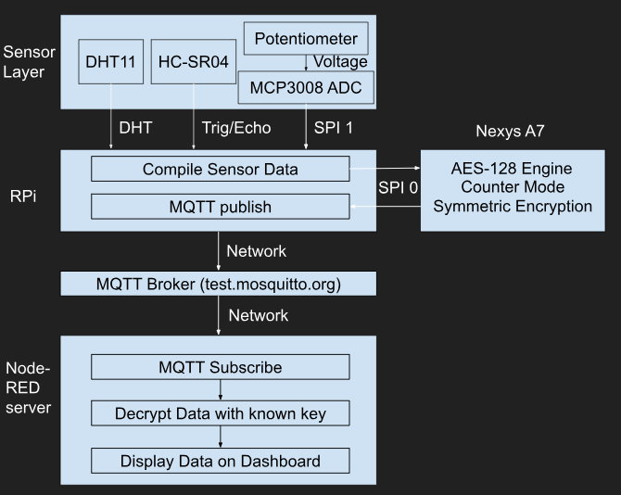

Methodology
Sensors collect raw data and sent it to the RPi
RPi formats data into 16-byte payload
nonce + counter generates AES-CTR input block
Counter block sent to FPGA via SPI
FPGA produces encrypted keystream
RPi XORs keystream with sensor data for ciphertext
published as JSON via MQTT
Node-RED server receives, decrypts, and displays data

Slide 6
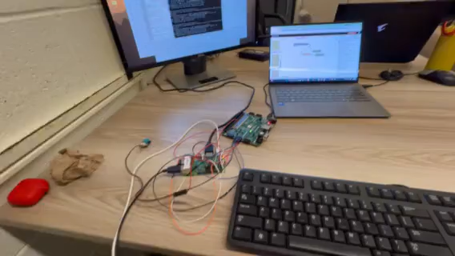
Demo

Slide 7
References
P. Cíbik, S. Ricci, Patrik Dobiáš, J. Hajný, L. Malina, and J. Havlín, “Quantum-resistant hardware-accelerated IoT traffic encryptor,” Internet of Things, pp. 101554–101554, Mar. 2025, doi: https://doi.org/10.1016/j.iot.2025.101554.
C. -C. Chang, W. -K. Lee, Y. Liu, B. -M. Goi and R. C. . -W. Phan, "Signature Gateway: Offloading Signature Generation to IoT Gateway Accelerated by GPU," in IEEE Internet of Things Journal, vol. 6, no. 3, pp. 4448-4461, June 2019, doi: 10.1109/JIOT.2018.2881425.
D. Evans, K. Brown, and P. Bond, “FIPS 197 Federal Information Processing Standards Publication Advanced Encryption Standard (AES),” Advanced Encryption Standard (AES), Nov. 2001, doi: https://doi.org/10.6028/NIST.FIPS.197-upd1.
‌

